Slide 1



Matrix – C++ project
朱俊达 郑瑞麒 王一帆

Slide 2


1. Introduction
Building a library for matrix computation
supports all standard numeric types
supports matrix and vector arithmetic
basic arithmetic reduction operations
Eigenvalues, inverse and computing determinant, convolutional operations
reshape and slicing
transfer the matrix from OpenCV

Slide 3
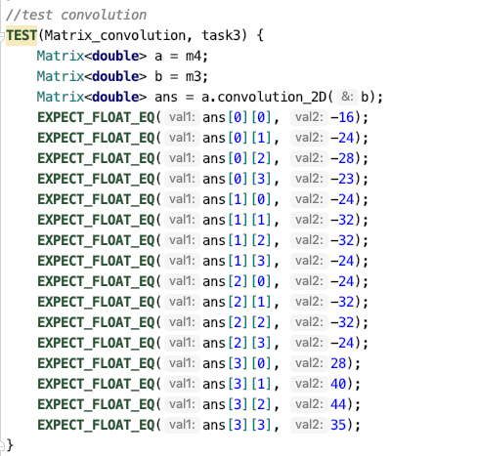
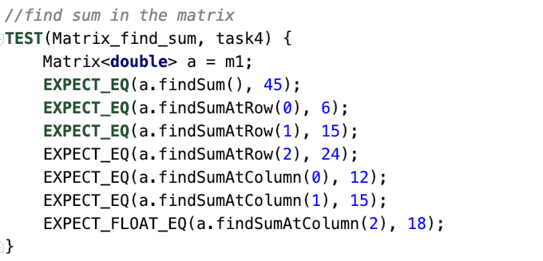
2. Highlight
Version control
Use Git to synchronize the development of the project. The link for the Github repository:
https://github.com/coda953/C-projcet
2. Detailed Readme
3. GoogleTest
GoogleTest

Slide 4
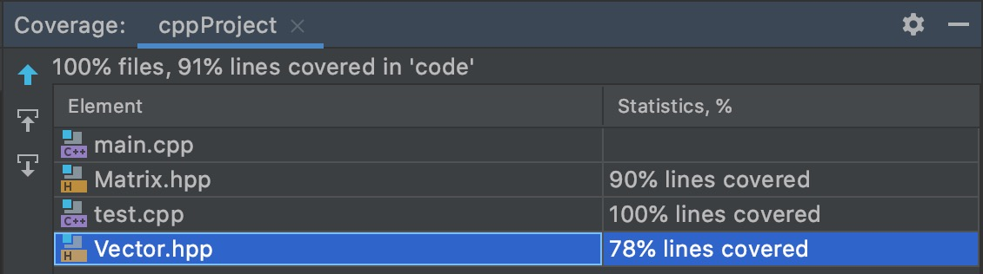
2. Highlight
4. Coverage tool – gocv
gocv

Slide 5
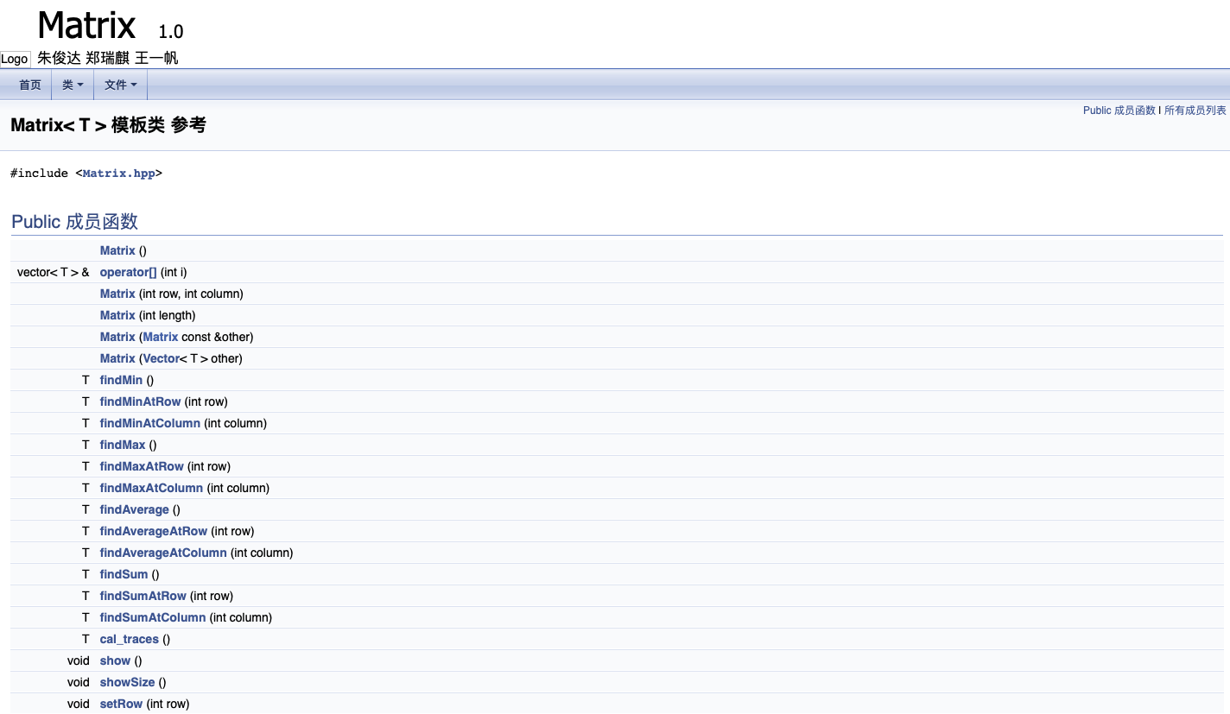
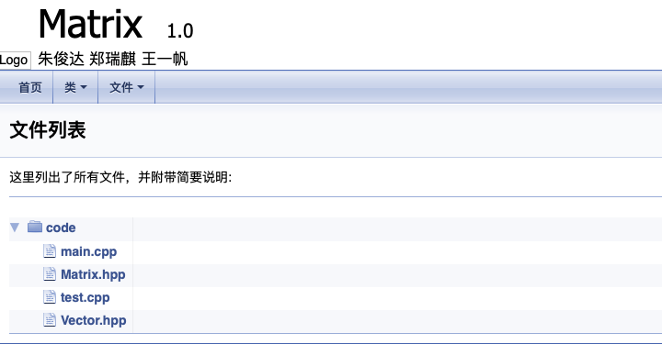
2. Highlight
5. Doxygen
Doxygen is the de facto standard tool for generating documentation from annotated C++ sources

Slide 6



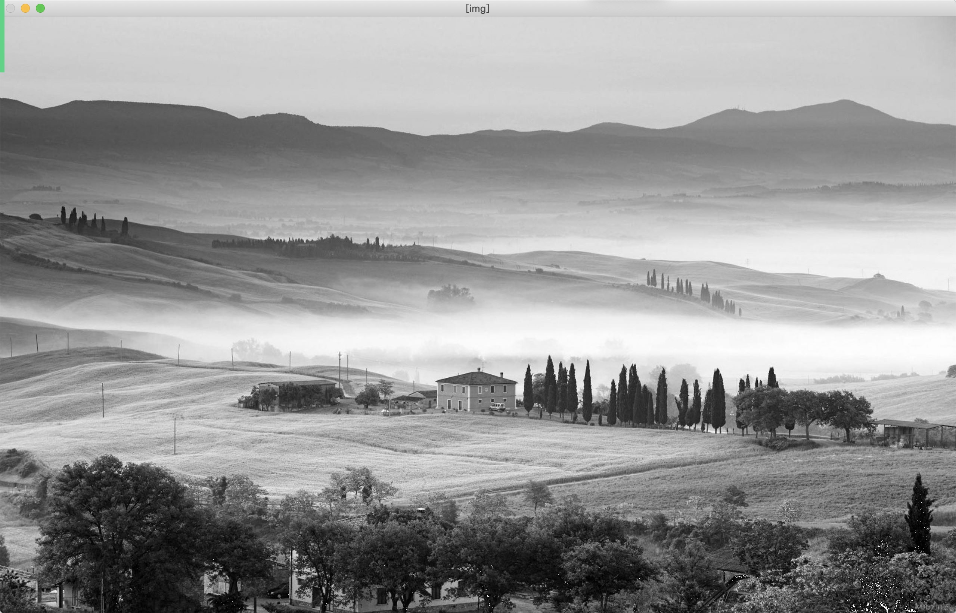
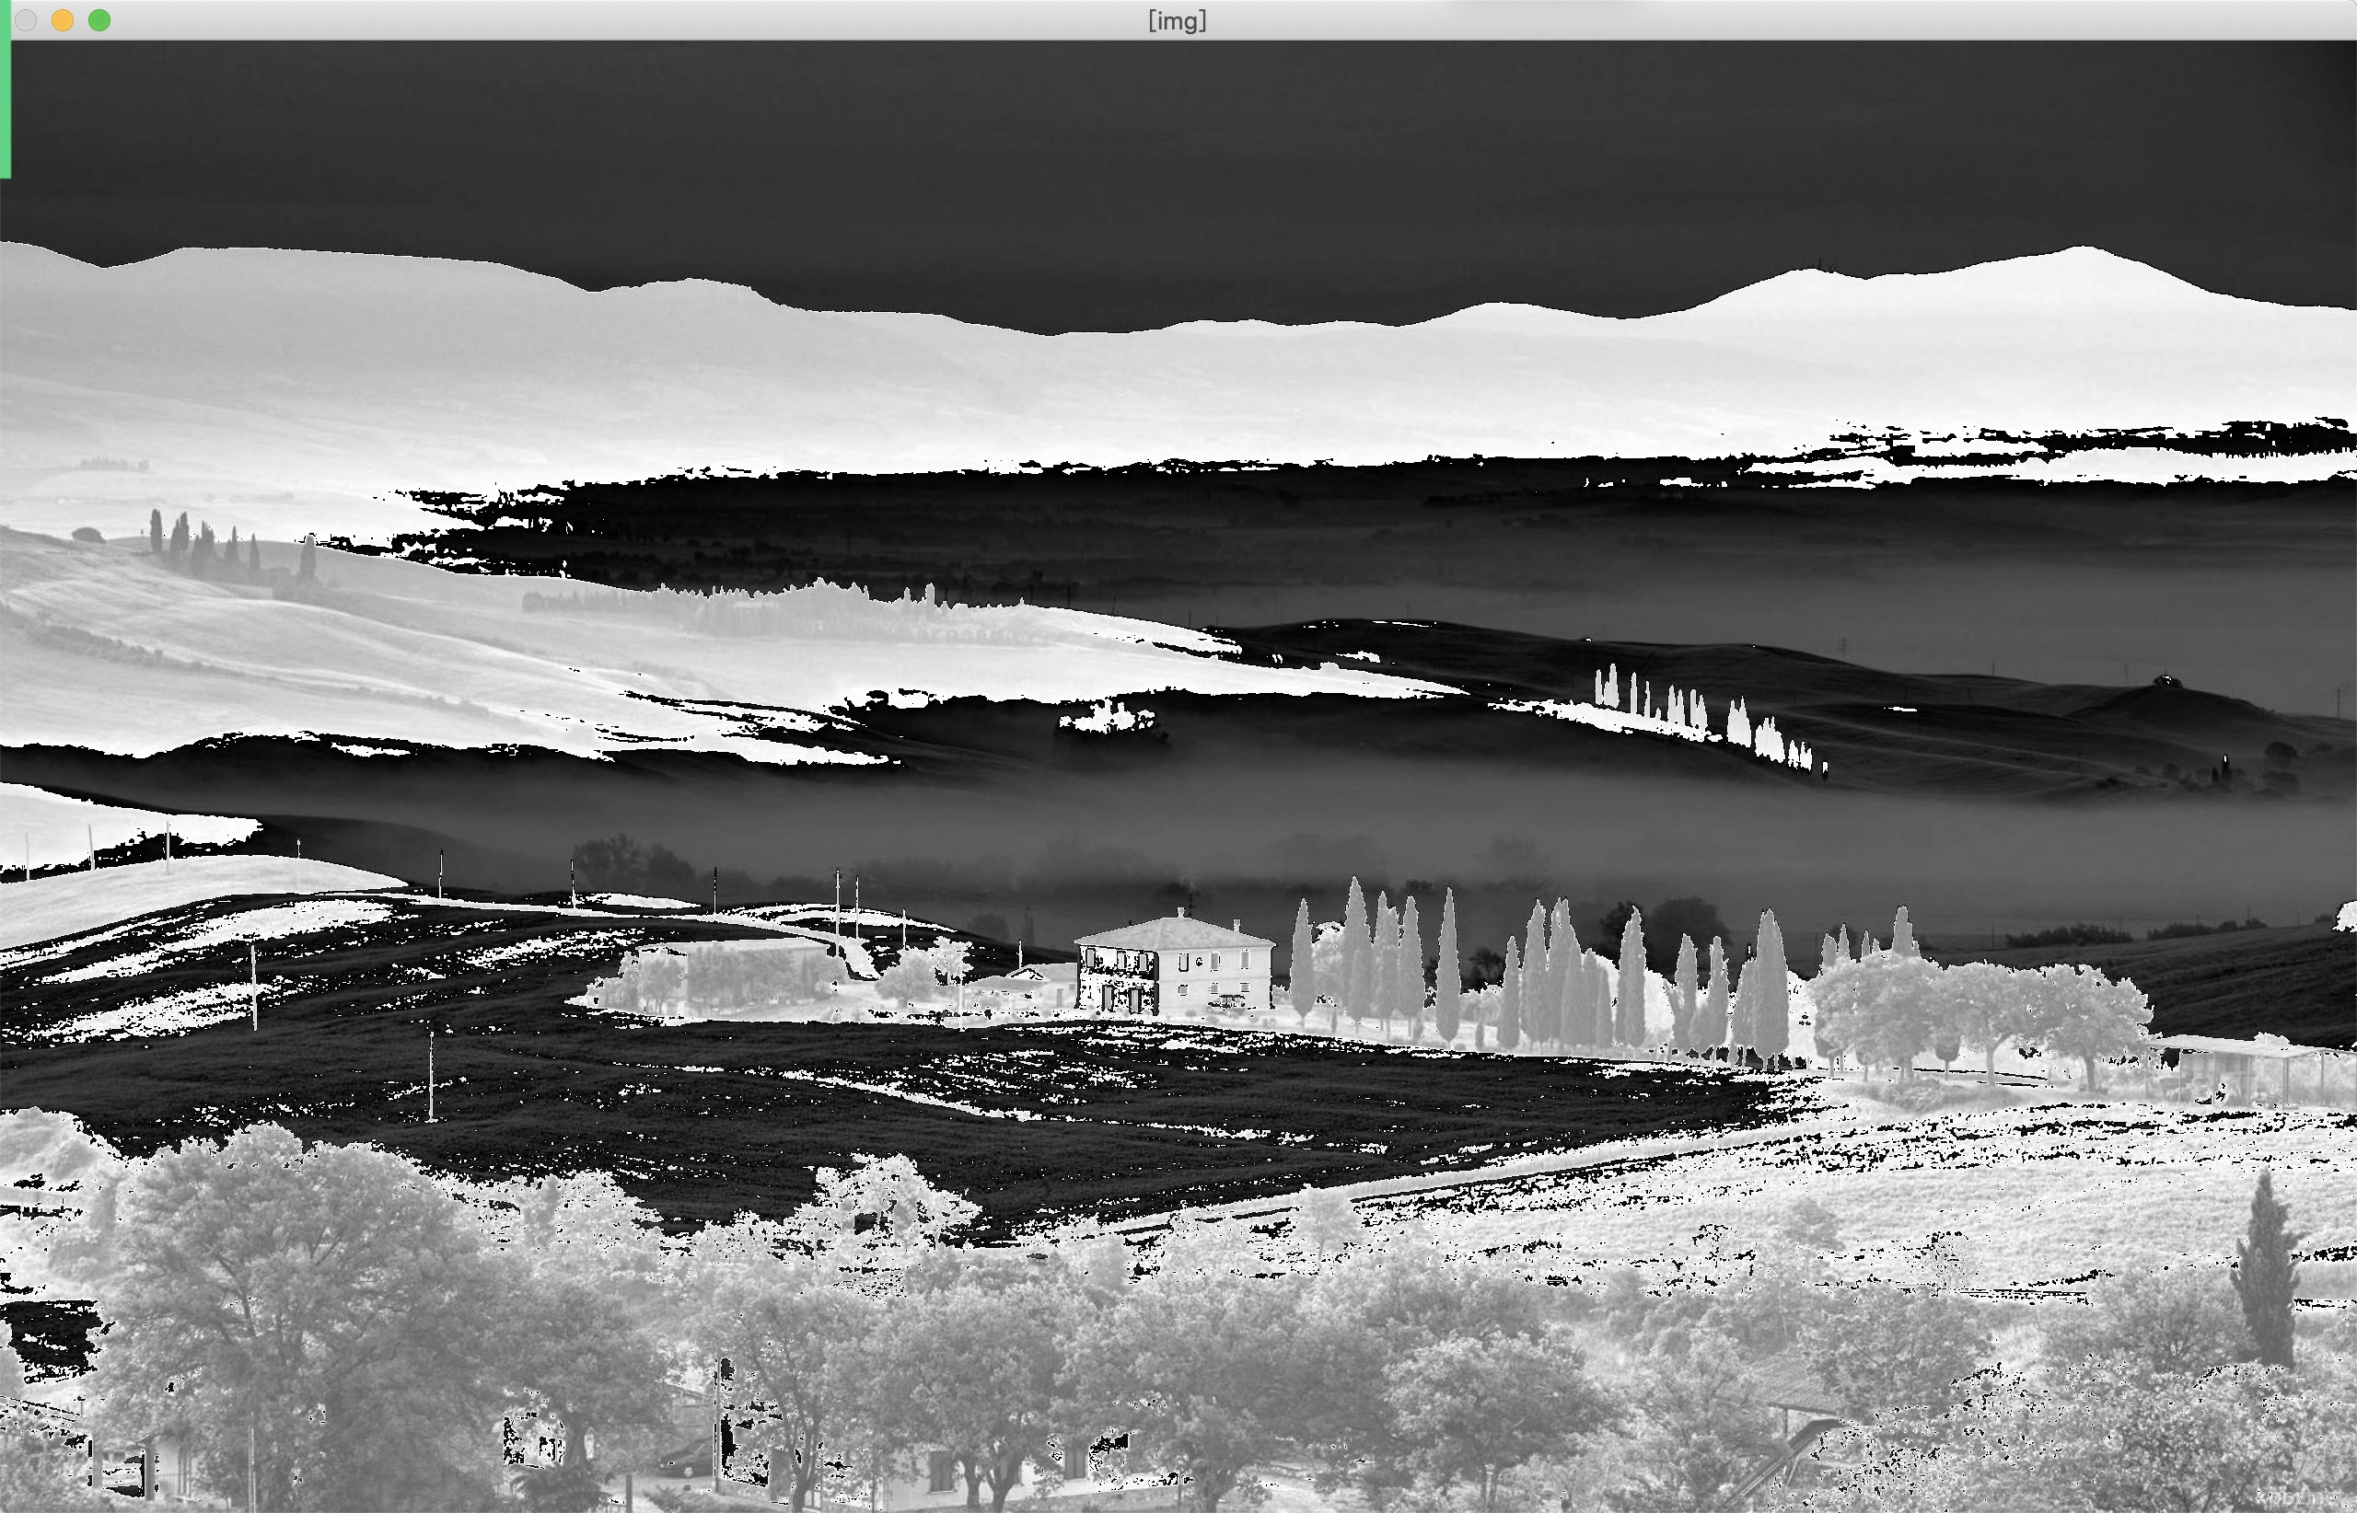
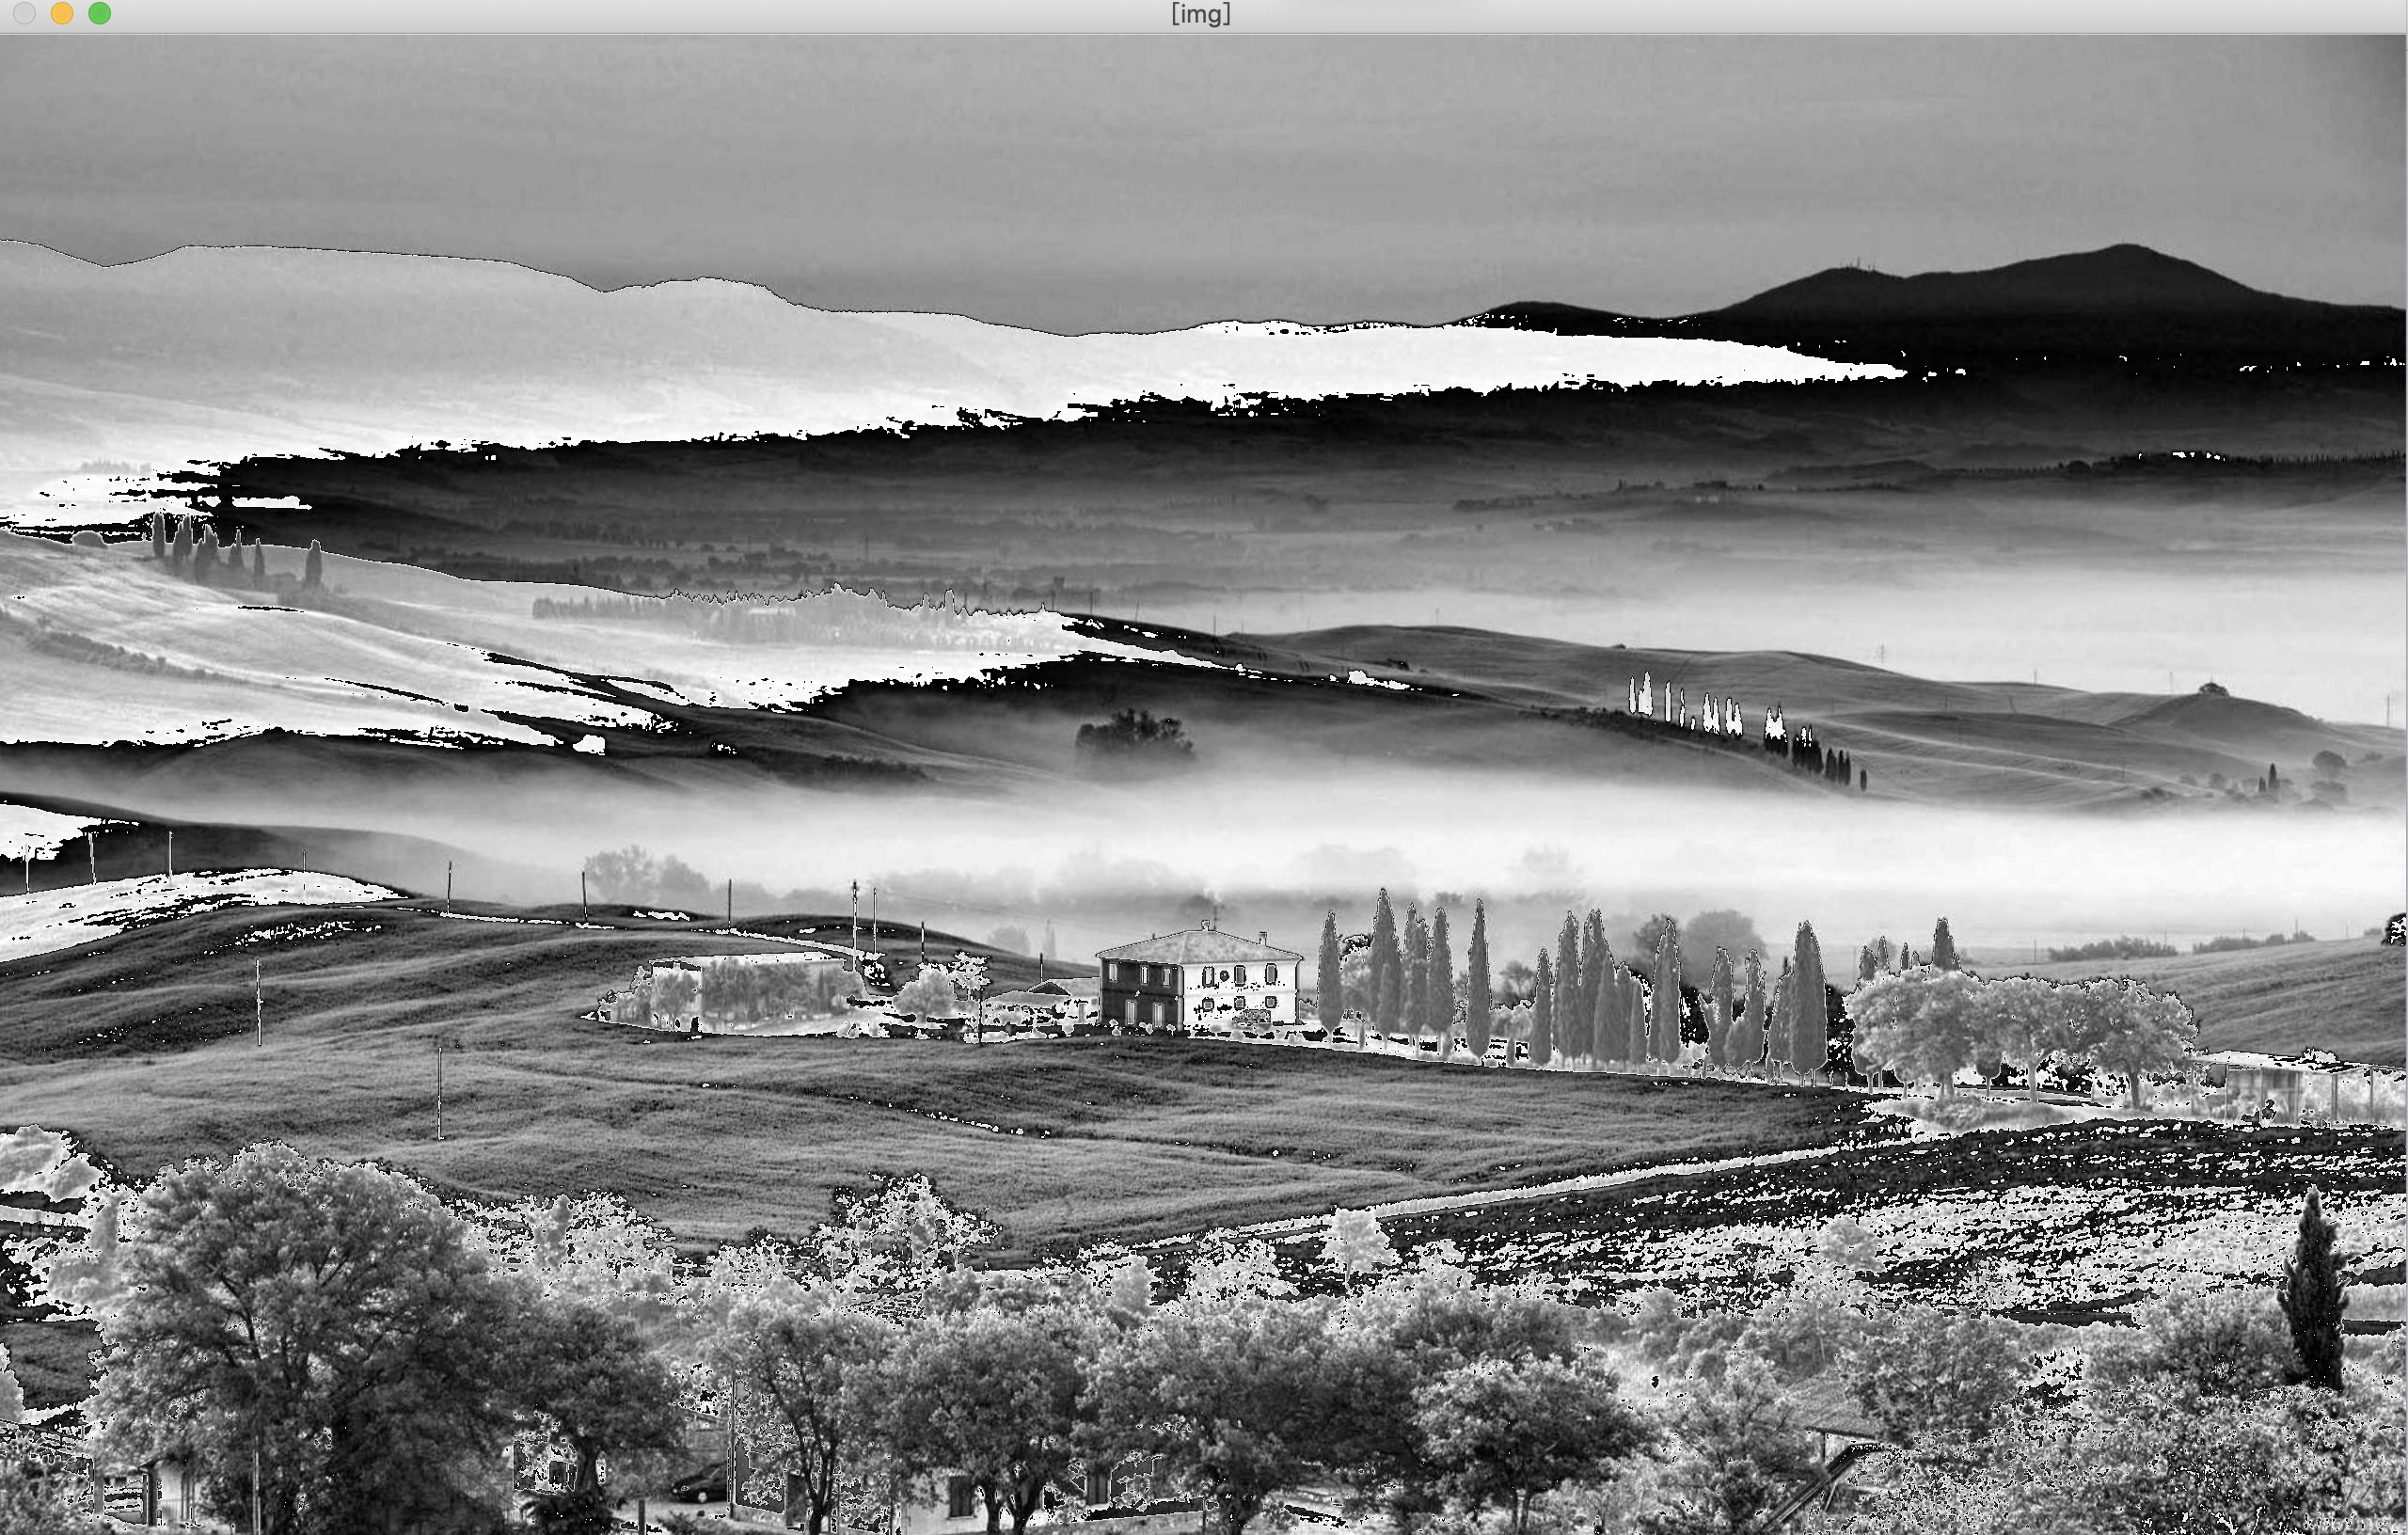
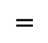
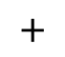
3. demo
transposition
$$+$$
$$=$$
Matrix to vector, add 100 grey degree to each element
Convolution 2D

